Slide 1
Big Data Overview

Slide 2
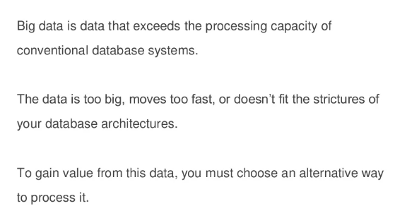
Introduction to Big Data

Slide 3
Big Data 4 Vs
Volume
Velocity
Variety
Veracity

Slide 4
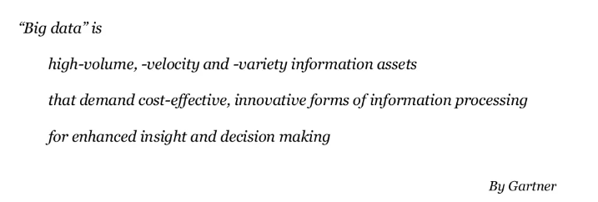
Big Data Definition

Slide 5
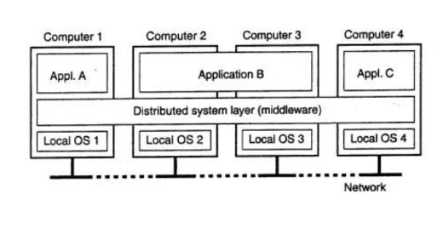
Distributed Systems

Slide 6
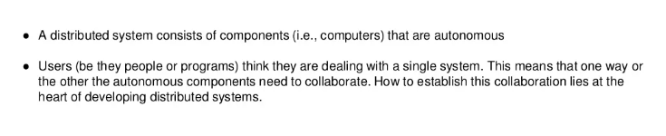
What is Distributed System

Slide 7
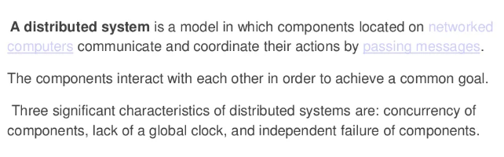
Distributed Systems Definition

Slide 8
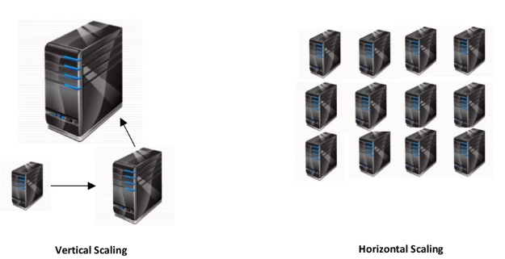
Horizontal Vs Vertical Scaling

Slide 9
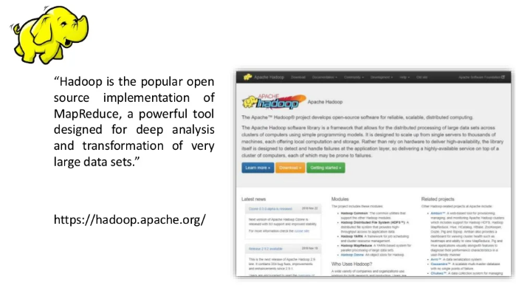
What is Hadoop

Slide 10
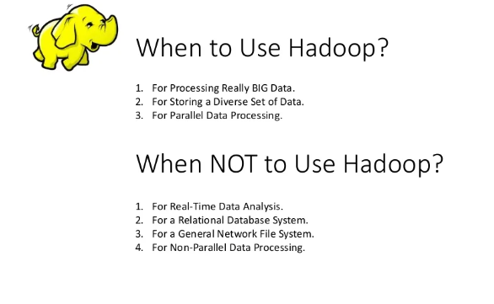

Slide 11
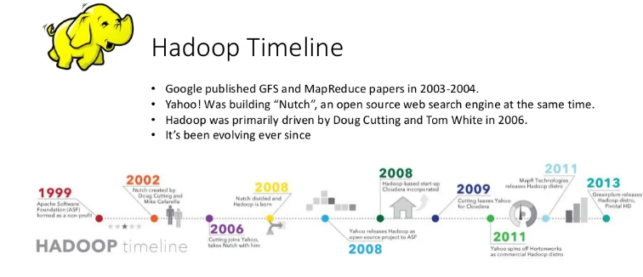

Slide 12
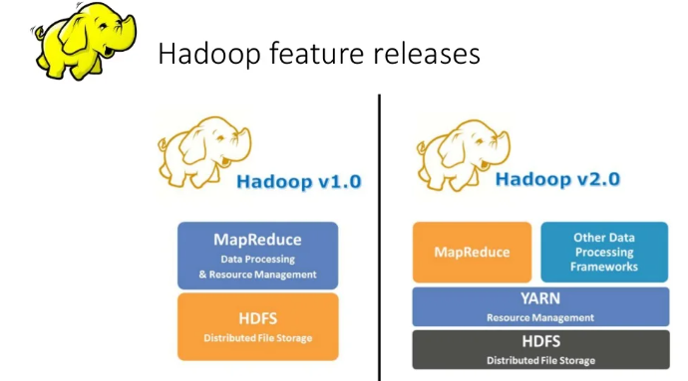

Slide 13
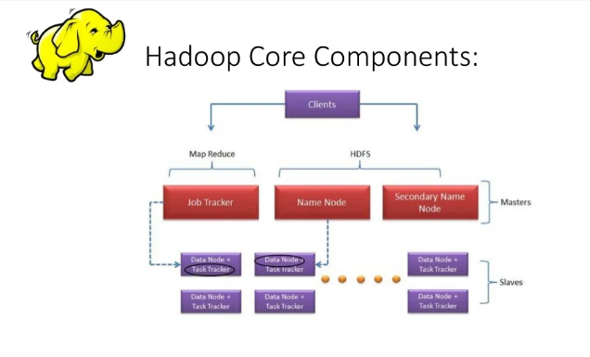

Slide 14
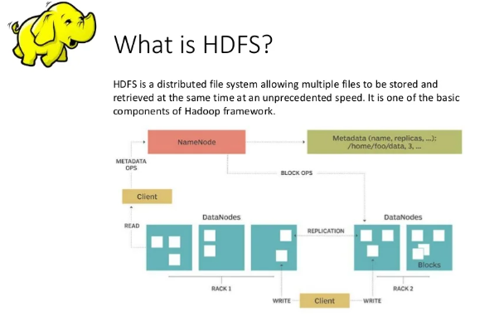

Slide 15
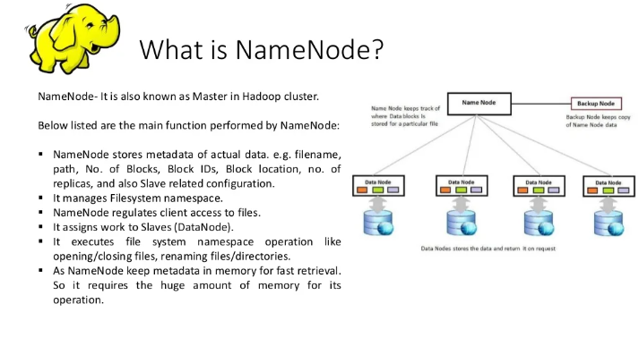

Slide 16
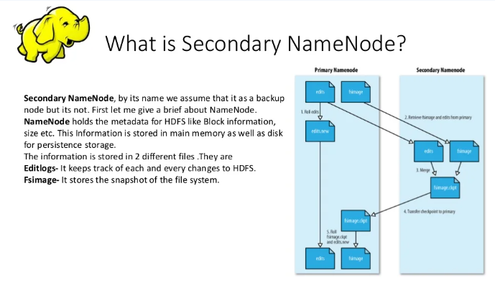

Slide 17
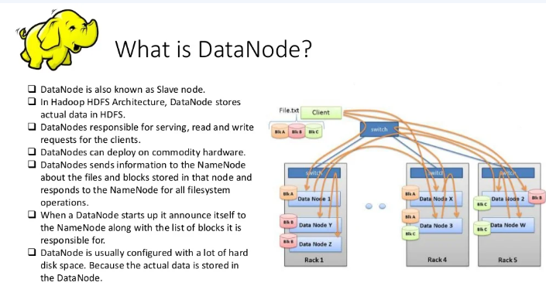

Slide 18
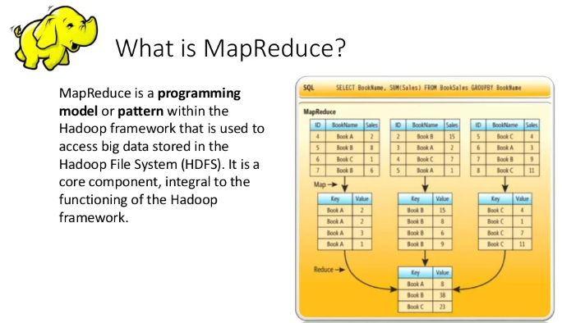

Slide 19
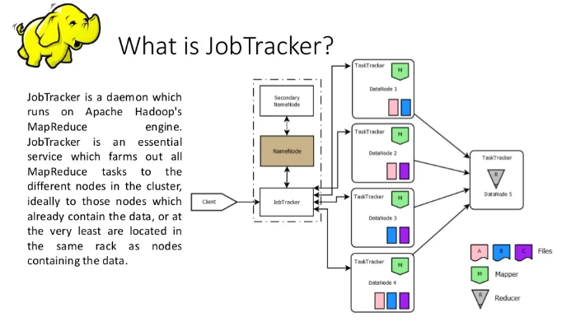

Slide 20
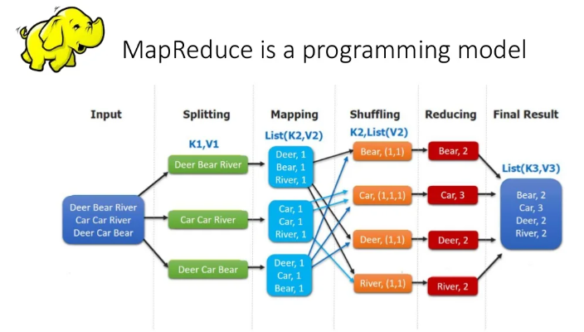

Slide 21
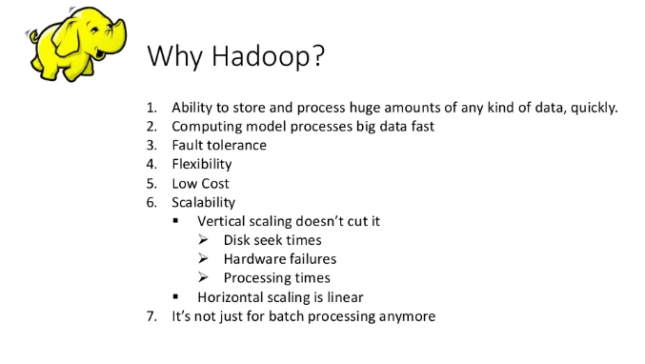

Slide 22
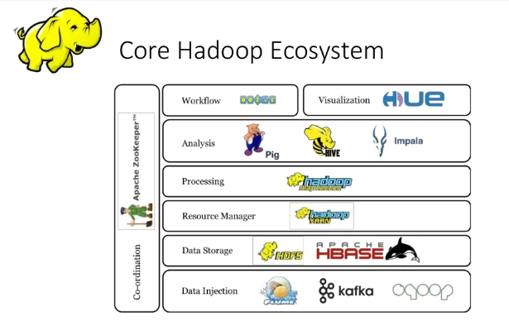

Slide 23
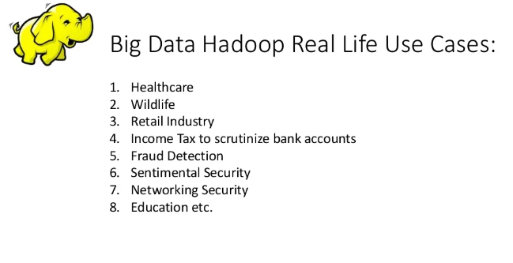

Slide 24
Apache Pig
Apache Pig is a platform for creating programs for Apache Hadoop by using a procedural language known as Pig Latin. Pig is an alternative to Java for creating MapReduce solutions, and it is included with Azure HDInsight.
Load: Read data to be manipulated from the file system.
Transform: Manipulate the data.
Dump or store: Output data to the screen or store it for processing.

Slide 25
Apache Hive
Apache Hive is a data warehouse system for Apache Hadoop. Hive enables data summarization, querying, and analysis of data. Hive queries are written in HiveQL, which is a query language similar to SQL.
Hive allows you to project structure on largely unstructured data. After you define the structure, you can use HiveQL to query the data without knowledge of Java or MapReduce.

Slide 26
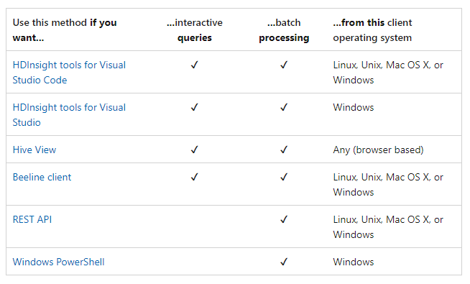
Scenario to use Hive

Slide 27
Apache Kafka
Apache Kafka is an open-source distributed streaming platform that can be used to build real-time streaming data pipelines and applications. Kafka also provides message broker functionality similar to a message queue, where you can publish and subscribe to named data streams.

Slide 28
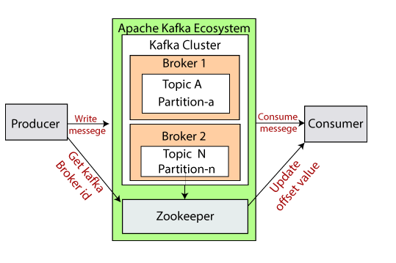
Kafka Ecosystem

Slide 29
Apache Kafka on HDI
It's a managed service that provides a simplified configuration process. The result is a configuration that is tested and supported by Microsoft.
Microsoft provides a 99.9% Service Level Agreement (SLA) on Kafka uptime. For more information, see the SLA information for HDInsight document.
It uses Azure Managed Disks as the backing store for Kafka. Managed Disks can provide up to 16 TB of storage per Kafka broker. For information on configuring managed disks with Kafka on HDInsight, see Increase scalability of Apache Kafka on HDInsight.

